Slide 1
<!DOCTYPE html> <html> <head> <meta charset="utf-8" /> <title>Page Title</title> <style> .main { background-color:#F00; width: 200px; height: 300px; } .relative { background-color: #00F; position: relative; top: 30px; color: #FFF; } .static { background-color: #0F0; } </style> </head> <body> <div class='main'> <div id="box1"> <p class="static">static</p> <p class="relative" >relative</p> </div> </body> </html>
relative:相對於原來的位置
static top,left 無效

Slide 2
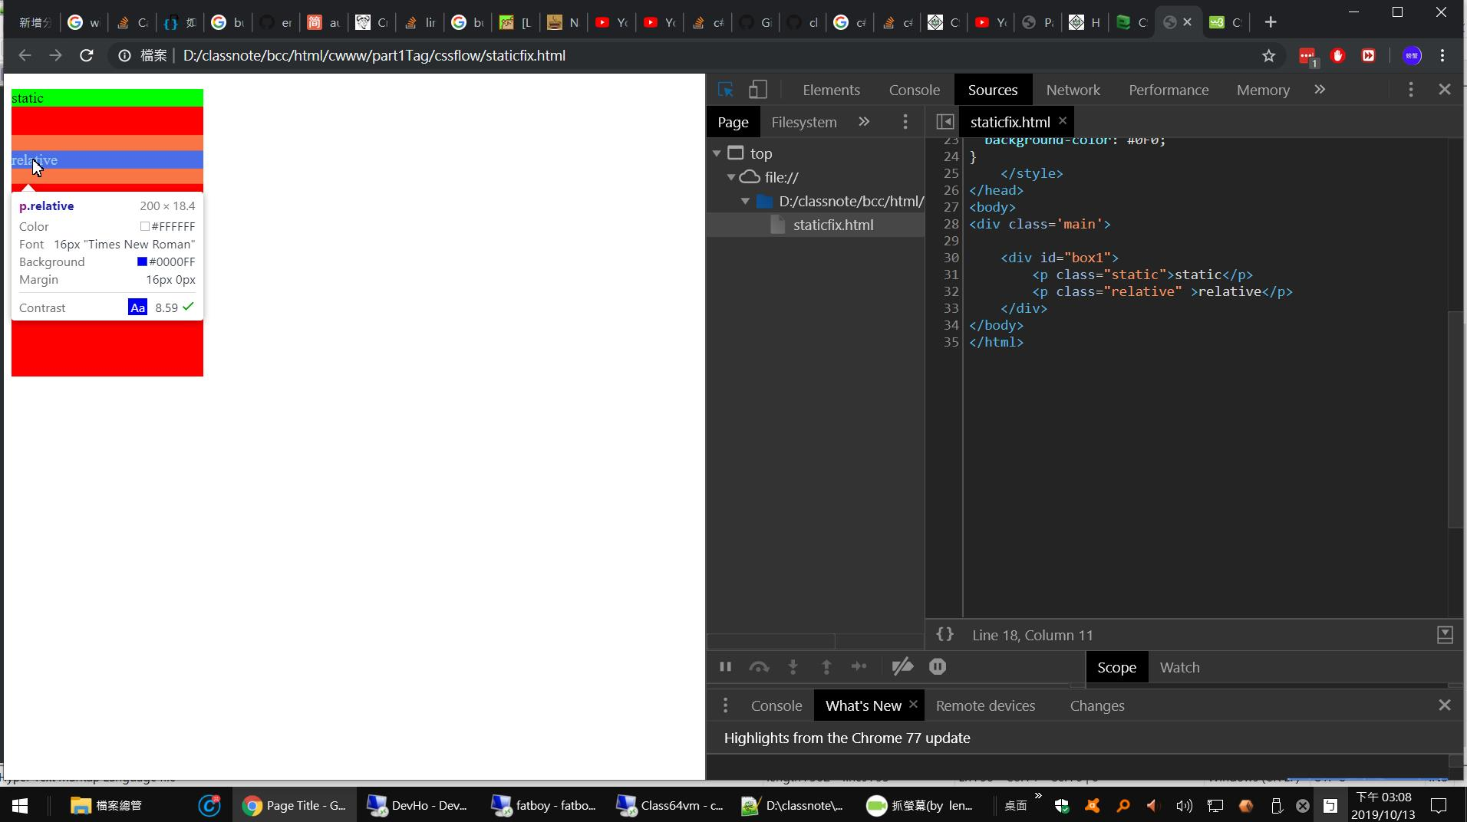
1
2

Slide 3
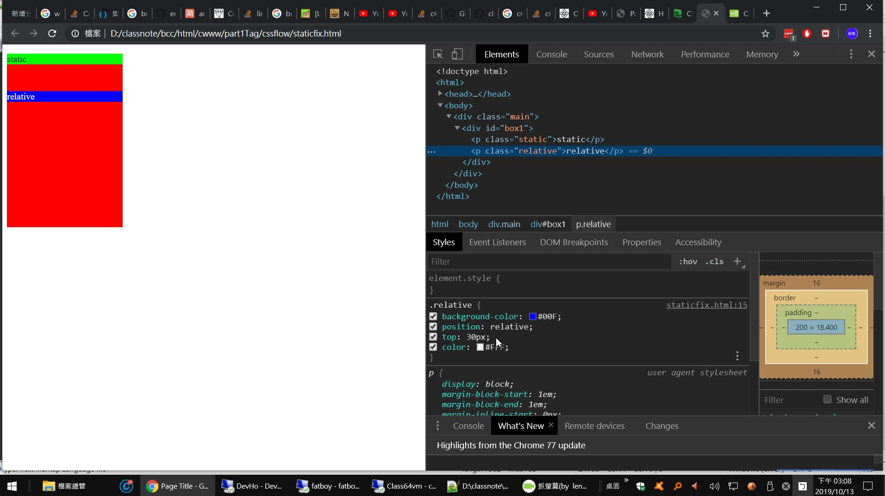
3e

Slide 4
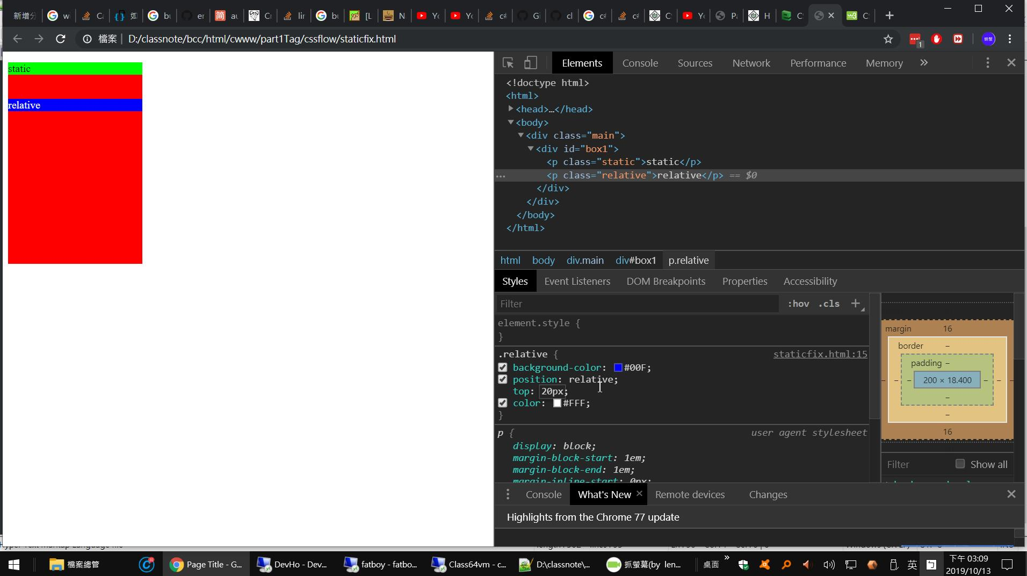

Slide 5

40px?

Slide 6


Slide 7


Slide 8


Slide 9

-10px 仍然還沒和綠色重疊
?

Slide 10
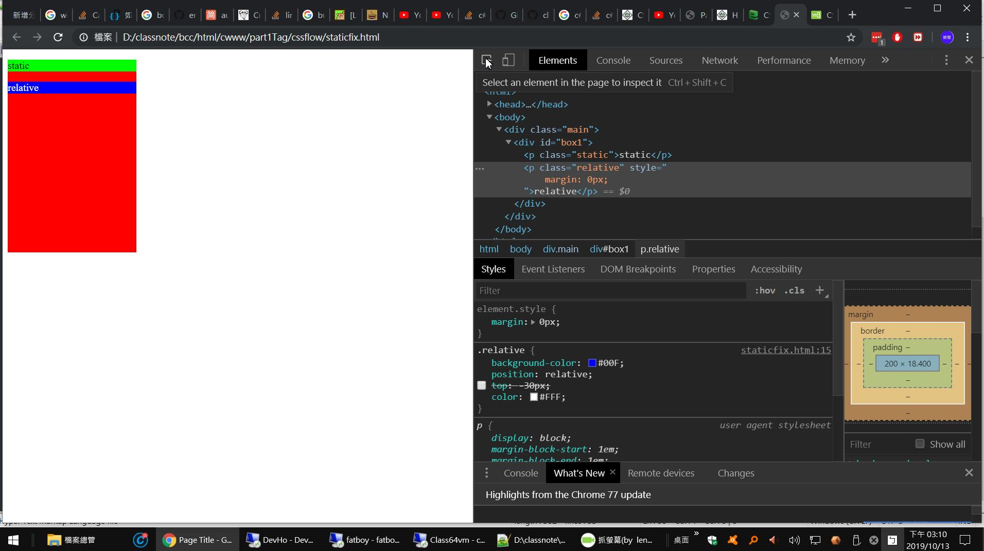
margin

Slide 11
